Slide 1
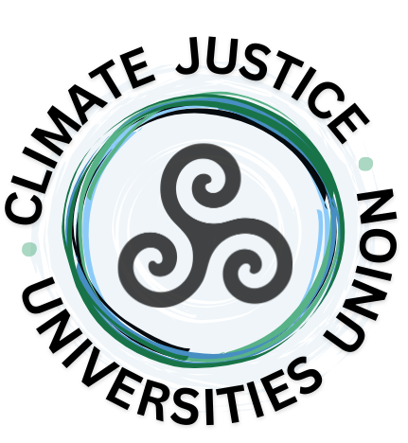
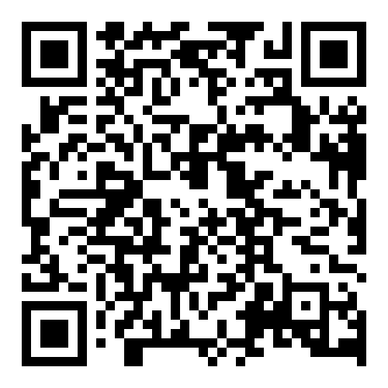
Do you want to
act on climate,
but find yourself unsure of
what to do or how?
Join us…
The CJUU is a transdisciplinary, international collective of people who are working to transform Higher Education to advance climate justice and accelerate a just transition.
Our members come from all over the world - from Higher Education institutions, diverse and creative communities, civil society organisations, and beyond. You can join us here (it’s free!):
climatejusticeuniversitiesunion.org

